Slide 1
Maximum Rectangular Area
In Histogram
By - Shobhit

Slide 2
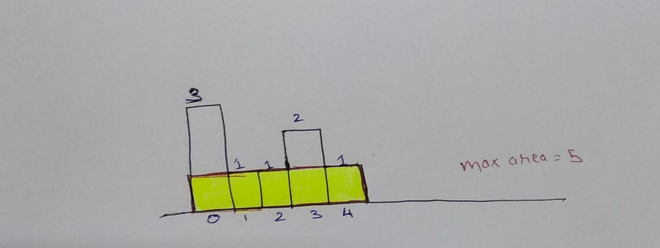
Overview:

Slide 3
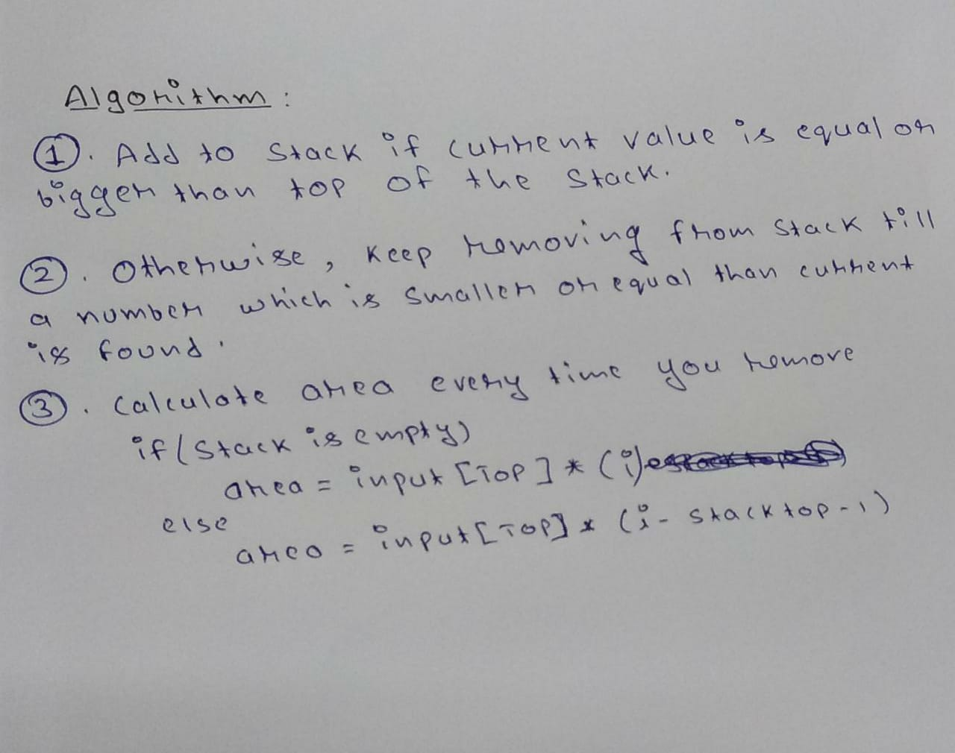
Algorithm:

Slide 4
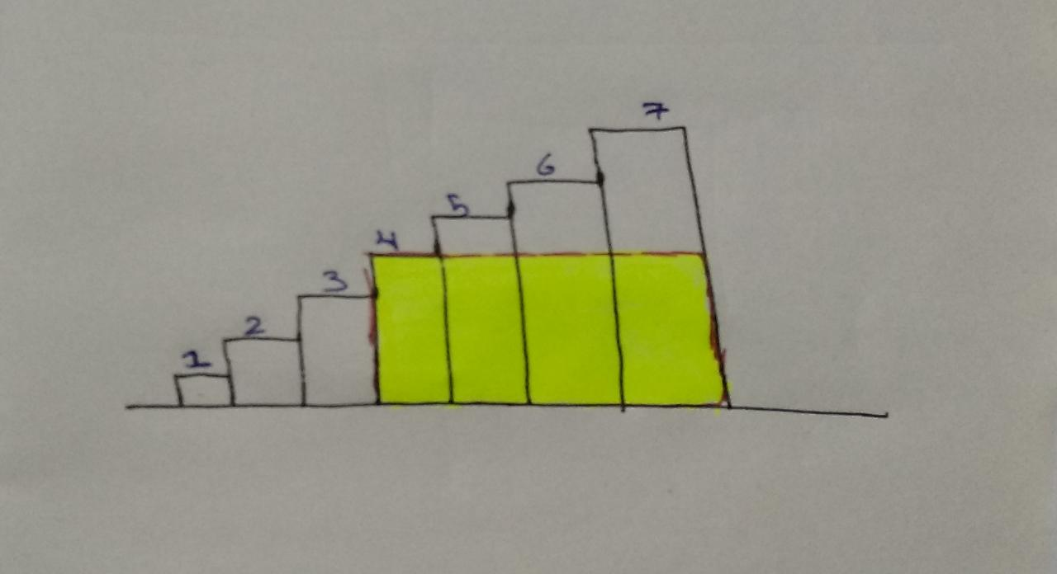

Slide 5
Code:
int largestRectangleArea(vector<int>& heights) {
stack<int>st;
int i, size_h = heights.size(), a, area = 0, max_area = 0, flag = 0;
for( i = 0; i < size_h; i++ )
{
if( !st.empty() && heights[st.top()] <= heights[i] )
st.push(i);
if(st.empty())
st.push(i);
while( !st.empty() && heights[st.top()] > heights[i] )
{
a = st.top();
st.pop();
if( st.empty() )
area = heights[a] * i;
else
area = heights[a] * (i - st.top() - 1);
if( max_area < area )
{
max_area = area;
}
flag = 1;
}
if( flag == 1 )
st.push(i);
flag = 0;
}

Slide 6
cont...
while( !st.empty() )
{
a = st.top();
st.pop();
if( st.empty() )
area = heights[a] * i;
else
area = heights[a] * (i - st.top() - 1);
if( max_area < area )
max_area = area;
}
return max_area;
}

Slide 7
THANK YOU

